Slide 1



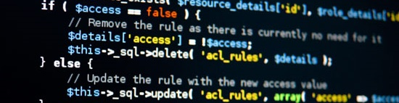
PHP MVC Frameworks
Course Introduction
SoftUni Team
Technical Trainers
Software University
http://softuni.bg

Slide 2

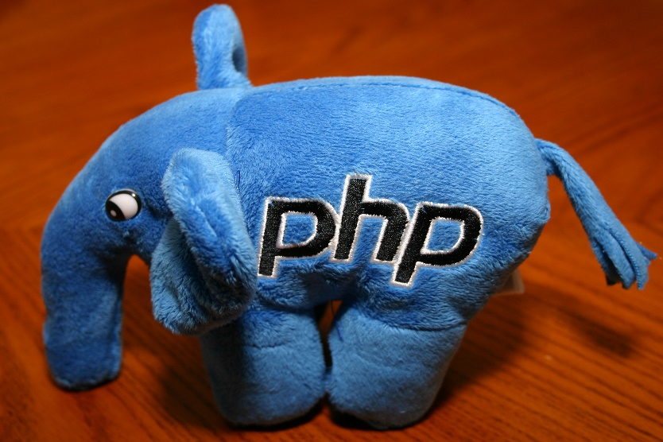
Table of Contents
Course Objectives
Course Program
Trainers Team
Examination
Learning Resources

Slide 3
Questions
sli.do #PHPMVC

Slide 4

PHP MVC Frameworks
Course Objectives & Program

Slide 5
PHP MVC Frameworks – Course Program
Course Introduction – Course Program, Exams, Trainers, Evaluation…
MVC Intro – What is MVC? Custom MVC Framework
Symfony Basics – Installation, Controllers, Routes
ORM Basics – What is ORM? Doctrine, Queries, Repositories
Symfony Fundamentals – Forms, Security
Symfony Advanced – Crons, Events, Deploy

Slide 6

Trainers Team
Borislav Yordanov
Web Developer and Technical Trainer
Solid programming experience with
PHP and Symfony

Slide 7
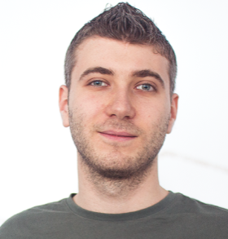
Trainers Team
Ivan Yonkov
Training Manager & Trainer @ SoftUni
5 years of programming experience mainly with Java and PHP
Solid experience as QA engineer
Top performing student from the Software University (2014)

Slide 8

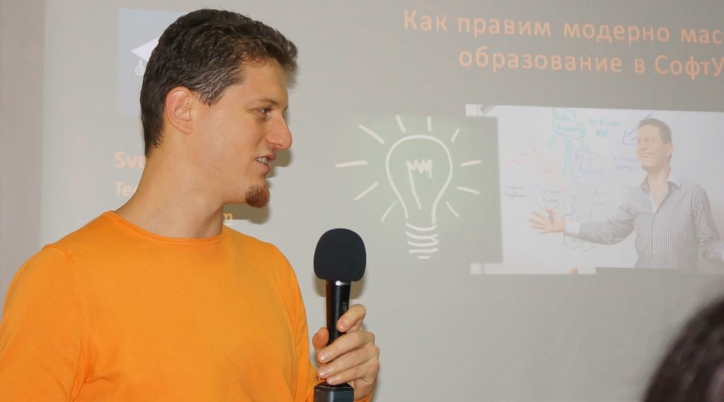
Training Structure – PHP MVC Frameworks
Lectures
Practical exercises (in class)
Homework (after every lecture or at home)
Individual project
Exam preparation (Workshop)
Project Defenses
Schedule: March - April 2017
Final date: 30 April 2017

Slide 9


Scoring System for the "PHP MVC Frameworks"
Project – 90%
Homework – 10%
Bonuses: up to 10%
Presence in class (onsite students only) – 5%
Forum Activity – 5%

Slide 10
Practical Project
Develop a practical project
Choose from existing projects
Or work on your own idea
Public defense → demonstrate your work live at SoftUni

Slide 11
Symfony Resources
Symfony - The Book - https://symfony.com/pdf/Symfony_book_3.1.pdf
The Cookbook - http://symfony.com/doc/2.3/cookbook/index.html (might be older)

